Slide 1

Name : Abdulmumin rabeea
Id: 200034799
Engineer: Mariam Farird

Slide 2
What is The Project ?
The idea of ​​the project is to create a scanner so that we can extract the tokens of the source code. This will be the first stage of the lexical parser compiler.

Slide 3
Definition About compiler Design
Compiler design is an important field in computer science that focuses on developing and understanding how to build and design compilers, which are the tools used to convert source code from a programming language into a form that can be executed by a computer. Here's an introduction to compiler design:
1. Main goal: The main goal of compiler design is to convert source code from a high-level programming language into a machine language (such as machine language or assembly language) that a computer can understand and execute.
2. Compiler components: A translator usually consists of three main components:
Analyzer: It divides the source code into small units and understands their linguistic structures.
Code Generator:It generates machine code or low-level programming code from source code.
Optimizer: It improves the generated source code to improve the performance of the resulting program.

Slide 4

Definition About compiler Design
3. Types of translators: Translators vary according to purpose and function, and can be divided into several types, such as:
Full Compiler: It converts the entire source code into automated code.
Interpreter: Interprets and executes the source code line by line.
Partial Compiler: It converts part of the source code into machine code while keeping the rest as source code.
4. Key concepts: Compiler design includes many key concepts such as syntax analysis, code generation, memory management, algorithmic optimizations, and others.
5. Challenges: Challenges in compiler design include accurately understanding and analyzing the source programming language, converting it into efficient and correct machine code, and improving the performance of the resulting code.
Compiler design is an interesting and complex topic in computer science, and forms an important basis for understanding the process of converting source code into executable code.

Slide 5
Introduction to language C-
C- language is a programming language that is considered a miniature version of the C programming language. It was developed by Dr. Richard Gould and others at the University of Cambridge in the late 1980s. The goal of C- language is to provide a simple and compact programming language for learning programming principles and developing programming skills.

Slide 6
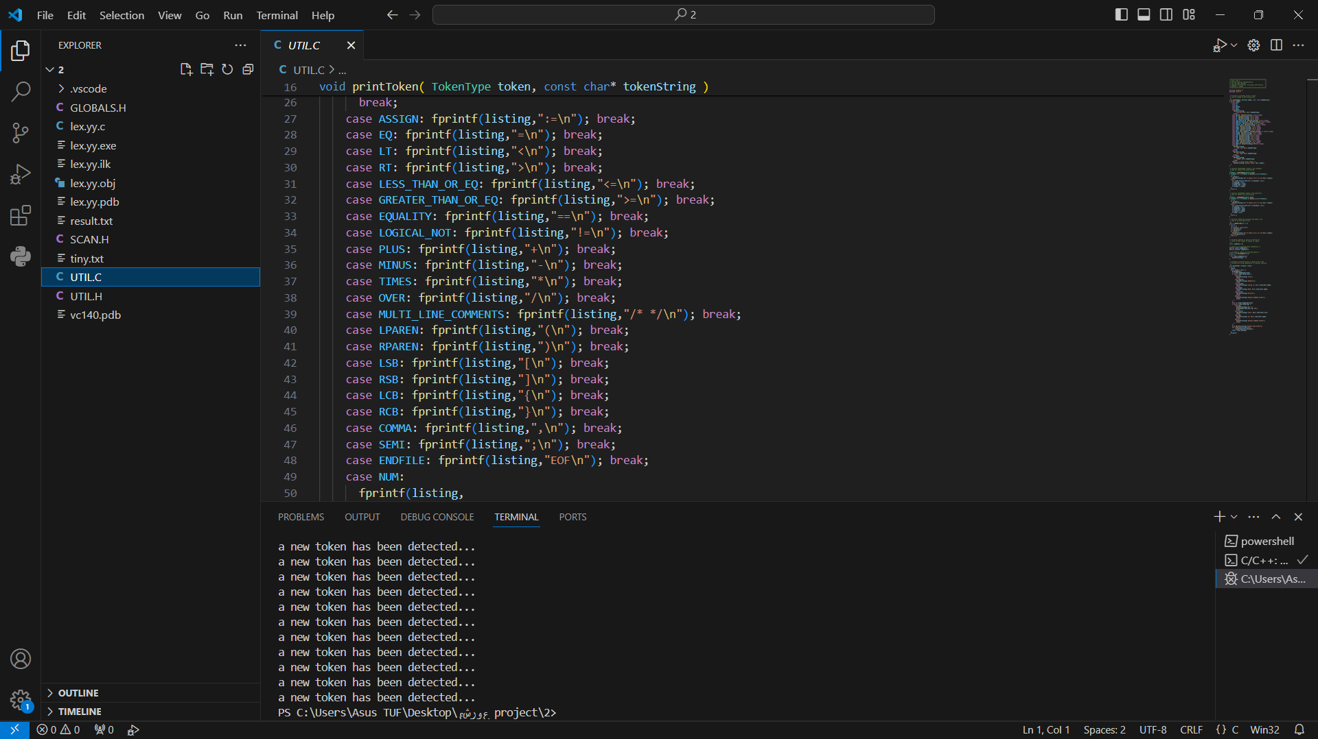

Slide 7
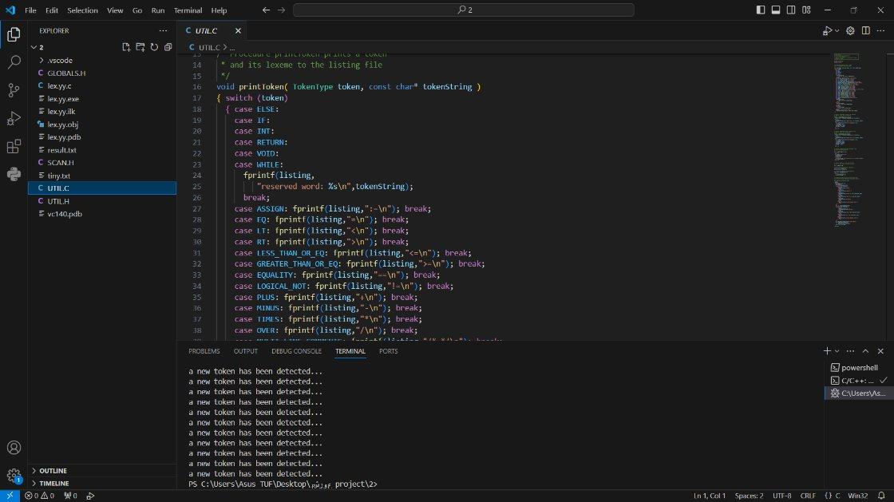

Slide 8
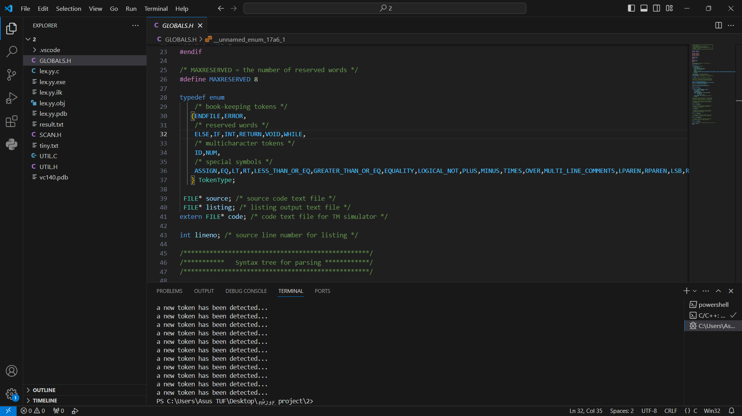

Slide 9
The End Thanks

